Slide 1
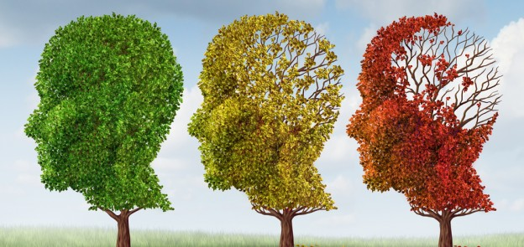
Alzheimer’s Disease
By Maria F. Chavez

Slide 2
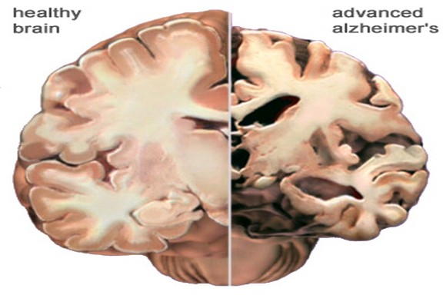
What is it?
A progressive disease that destroys memory and other important mental functions
It attacks neurons resulting in loss of memory, thinking and language skills, and behavioral changes.
Mostly affects people 65 years +
Three Stages
Average lifespan after symptoms become noticeable is 8 years
Range of survival is 4-20 years after
There is no current cure
Notes:
60-80% of cases of dementia
prime suspects in damaging and killing nerve cells. plaques and tangles
Plaques are deposits of a protein fragment called beta-amyloid (BAY-tuh AM-uh-loyd) that build up in the spaces between nerve cells.
Tangles are twisted fibers of another protein called tau (rhymes with “wow”) that build up inside cells.

Slide 3
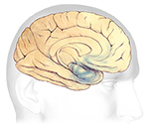
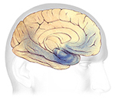
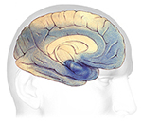
What is it?
Plaques- deposits of beta-amyloid that build up in the spaces between nerve cells.
Tangles- twisted fibers of tau that build up inside cells.
Notes:
Plaques are deposits of a protein fragment called beta-amyloid (BAY-tuh AM-uh-loyd) that build up in the spaces between nerve cells.
Tangles are twisted fibers of another protein called tau (rhymes with “wow”) that build up inside cells.
are produced a lot more in people with alzheimers
more predictable patterns

Slide 4
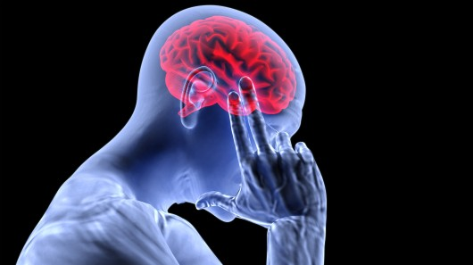
Causes
Age
Family History
Head Trauma
Heart-Head Connections
high blood pressure, heart disease, stroke, diabetes and high cholesterol.

Slide 5
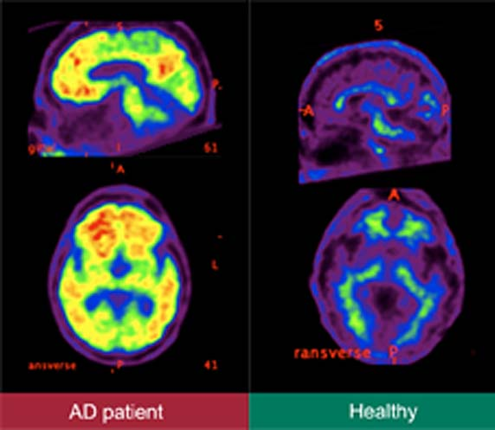
Diagnosis
The only definitive method of diagnosis is examination of brain tissue obtained from a biopsy or autopsy.
A thorough medical history
Mental status testing
A physical and neurological exam
Tests (such as blood tests and brain imaging) to rule out other causes of dementia-like symptoms
Notes:
Clinically there isn’t a test
Usually several tests are performed to rule out any other cause of dementia.

Slide 6
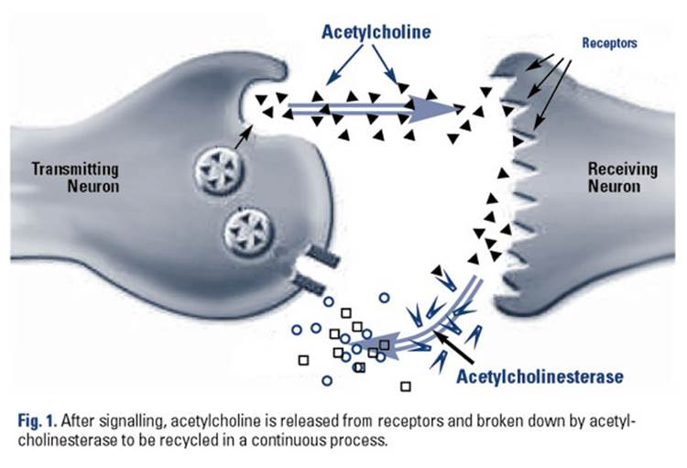
Treatment
For cognitive symptoms:
Cholinesterase inhibitors (Aricept, Exelon, Razadyne)
Prevent the breakdown of acetylcholine
Memantine(Namenda)
Regulates the activity of glutamate
Some doctors prescribe high doses of vitamin E for cognitive changes
Notes:
ffecting certain chemicals involved in carrying messages among the brain's nerve cells.
drug and non-drug treatments may help with both cognitive and behavioral symptoms.
acetylcholine a chemical messenger important for learning and memory
glutamate, a different messenger chemical involved in learning and memory.

Slide 7
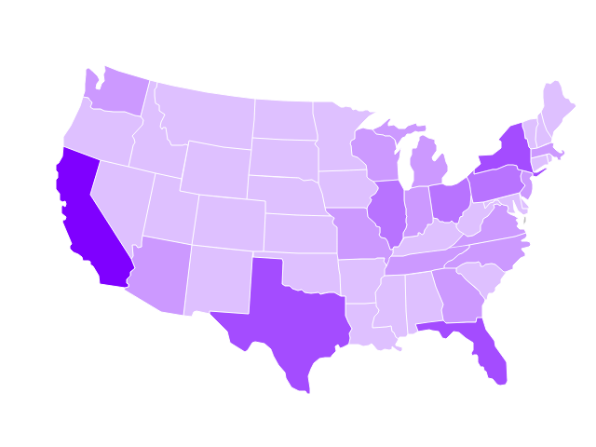
National US Statistics
It is the 6th leading cause of death in the U.S
Almost ⅔ of Americans with Alzheimer’s disease are women
1 in 3 seniors die with Alzheimer’s or another dementia.
5.3 million
5.1 million are 65+
Older African-Americans and Hispanics are more likely than older whites to have Alzheimer's disease.
In 2015, an estimated 700,000 people in the U.S will die from Alzheimer’s.
Notes:
3.2 million are women and 1.9 million are men.
By 2050, the number of people age 65 and older with Alzheimer's disease may nearly triple, from 5.1 million to a projected 13.8 million

Slide 8
Utah Statistics
29,000 Total People in 2015
10% of Seniors
412 deaths in 2012

Slide 9
Sources
http://www.alz.org/alzheimers_disease_what_is_alzheimers.asp
http://www.alz.org/facts/
http://www.alz.org/documents_custom/facts_2015/alz_ff_utah.pdf?type=interior_map&facts=undefined&facts=facts
http://www.alz.org/alzheimers_disease_stages_of_alzheimers.asp?type=carecenter_footer
http://www.alzfdn.org/AboutAlzheimers/definition.html
http://www.alz.org/alzheimers_disease_treatments.asp?type=alzFooter
http://www.alz.org/alzheimers_disease_diagnosis.asp
http://alz.org/texascapital/documents/How_is_AD_Diagnosed.pdf

