Slide 1
Dental Health
By: Maria F. Chavez

Slide 2
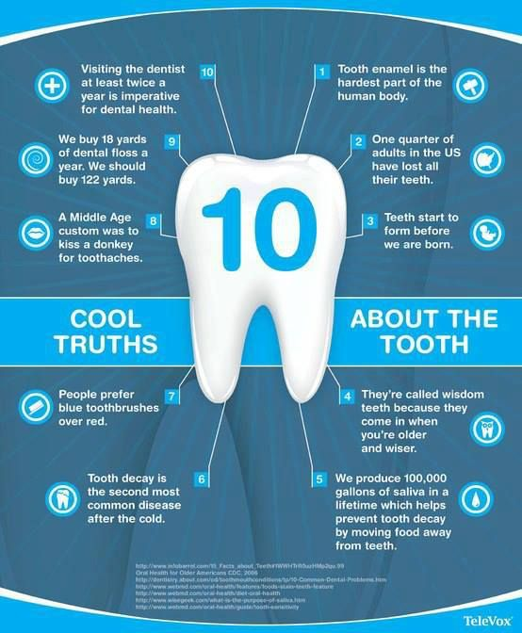
Fun Facts
The Average person spends 38.5 days brushing their teeth over their lifetime.
In your lifetime, your mouth can produce enough saliva to fill up 2 swimming pools.
Everyone has a unique tongue print.
If you're right handed, you will chew your food on your right side. If you're left handed, you will tend to chew your food on your left side.
The average woman smiles 62 times a day. The average man smiles about 8 times a day

Slide 3
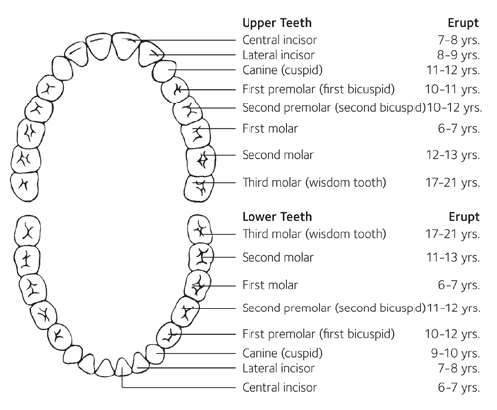
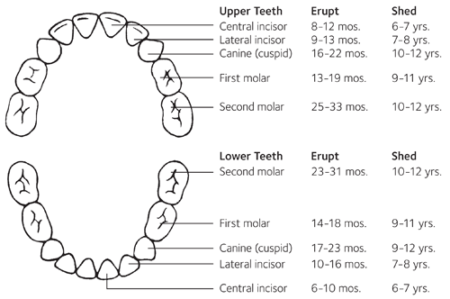
The Teeth
Notes:
TALK ABOUT FUNCTIONS IN SPEECH, EATING,

Slide 4
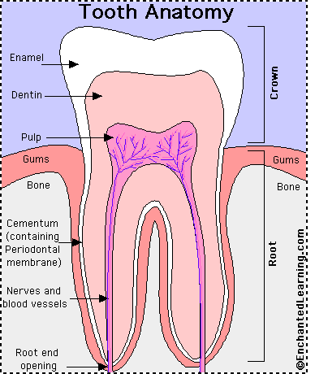
Parts of the Tooth

Slide 5

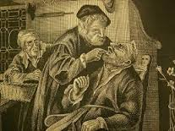

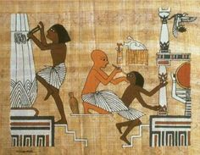
A Brief History
Rough cloths and water
Chinese and Egyptians
Salt and chalk.
Ashes
Ancient Greeks and Romans crushed oyster shells and bones.
  Pumice, talc, alabaster, coral powder, iron rust as toothpaste.
1400s- First Toothbrush
  bristles from pig’s necks attached to bone/bamboo handles.
1770 (England) William Addis
1930s The Invention of Nylon
WW2
1882 Floss

Slide 6
Basic Dental Care

Slide 7
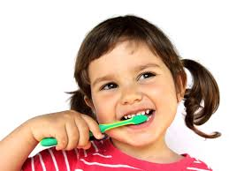
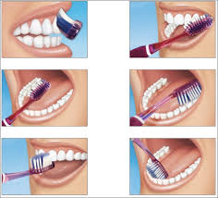
Brushing Techniques
2x a day
Electric Toothbrushes
Brush at Neck and all around tooth
Tongue
Keep Equipment Clean
  Air Drying
  Upright Position
  Don’t cover/Store in close containers
Get a New Toothbrush every 3-4 months
Notes:
Cross contamination

Slide 8
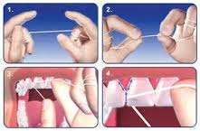
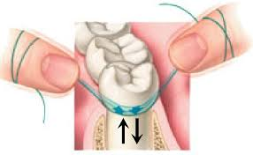
Flossing
18 inches
Curve against tooth when it reaches gumline
Slide it in the space between the gum and the tooth.
Rub the floss on the side of the tooth in an up and down motion
Alternatives: Pre-threaded flosser, tiny brushes,wooden/silicone plaque remover.

Slide 9


Nutrition
Fruit and veggies are naturally abrasive and can help remove some of the substances that discolor your teeth.
Calcium strengthens the enamel
Avoid foods high in sugar, carbohydrates, and acid. ( bread, fish, fruit juice)
Notes:
Tooth grinding- sleep , stress, night guard
Halitosis- bad breath
Breaking teeth
Color changing bristles
TALK ABOUT PLAQUE

Slide 10
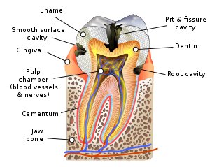
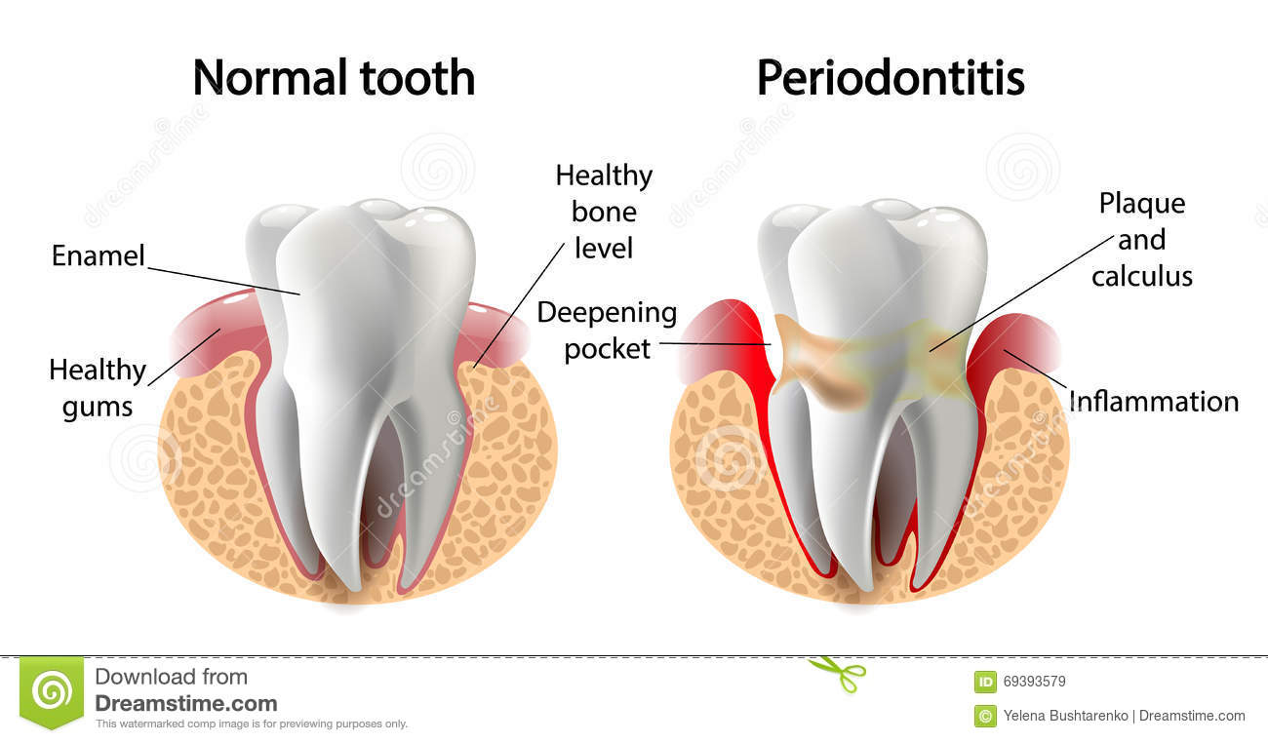
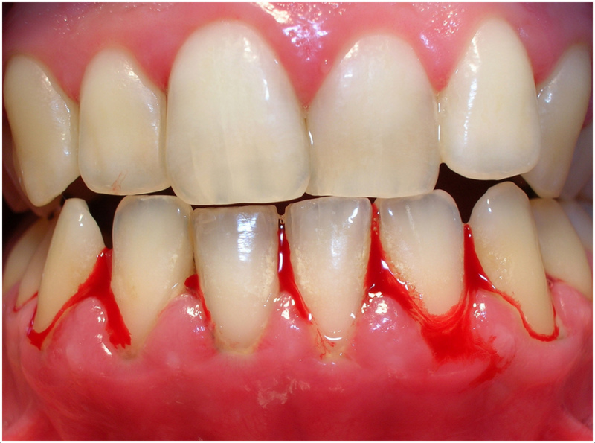

Results of bad dental care
Tooth Decay
Gingivitis
Heart Disease
Strokes
Diabetes
Kidney Disease
ETC…..

Slide 11
Questions?

