Slide 1
How Can I Do A Figure Skating Sit-Spin?
By: Maria F. Chavez

Slide 2
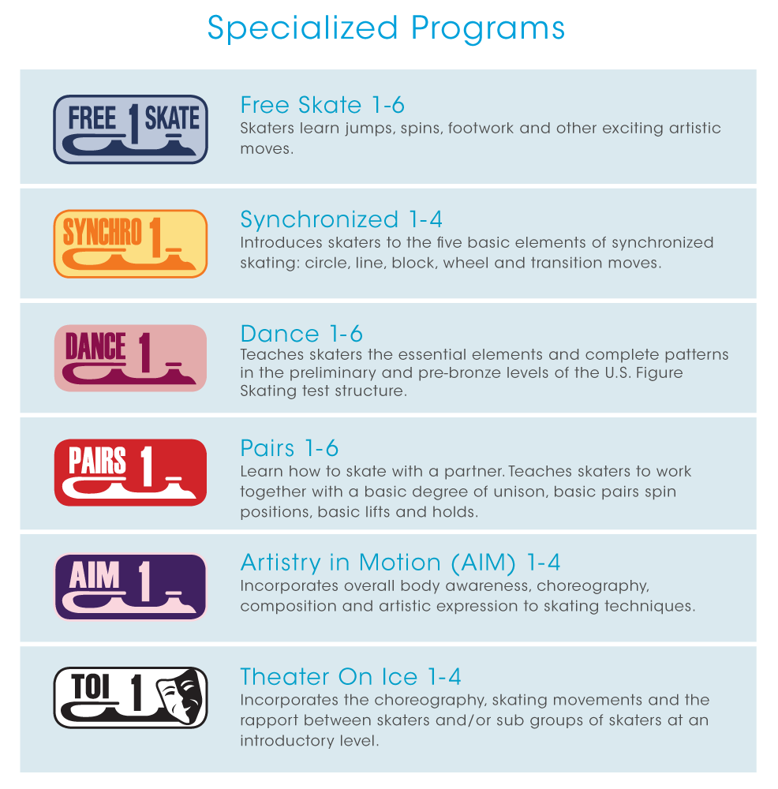
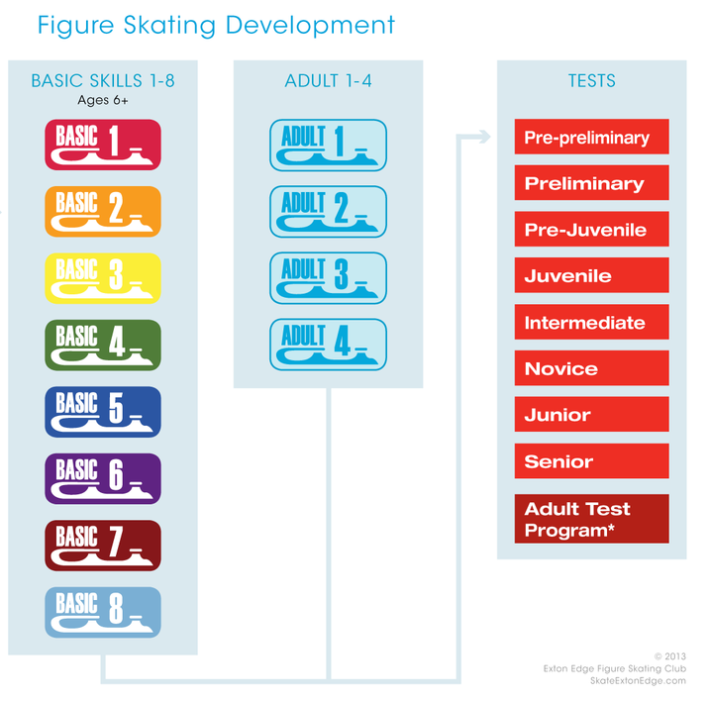
Figure Skating (Basic Levels)

Slide 3
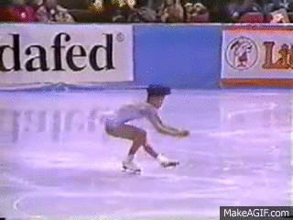
What’s a Sit Spin?
The sit spin is one of the three basic figure skating spin positions. It is defined by a squatting position in which the skater's buttocks are below the knee of the skating leg

Slide 4
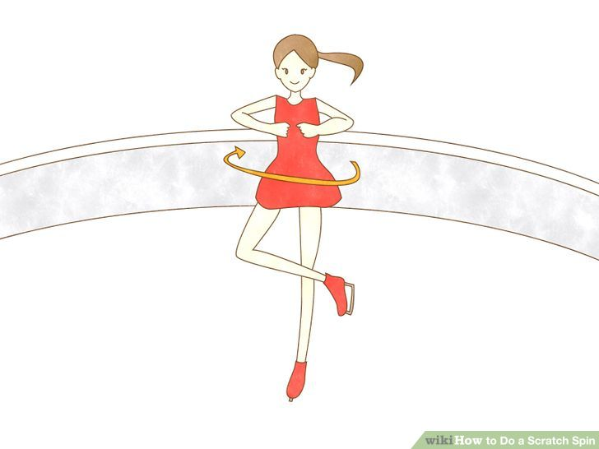
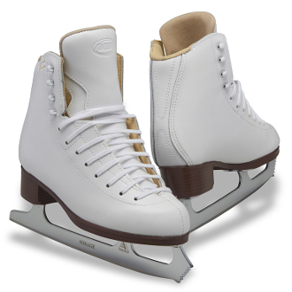
Preceding Moves and Equipment
Scratch Spin
Shoot-the duck
Backwards crossovers
Left outside edge
GAM Concepts G0470

Slide 5
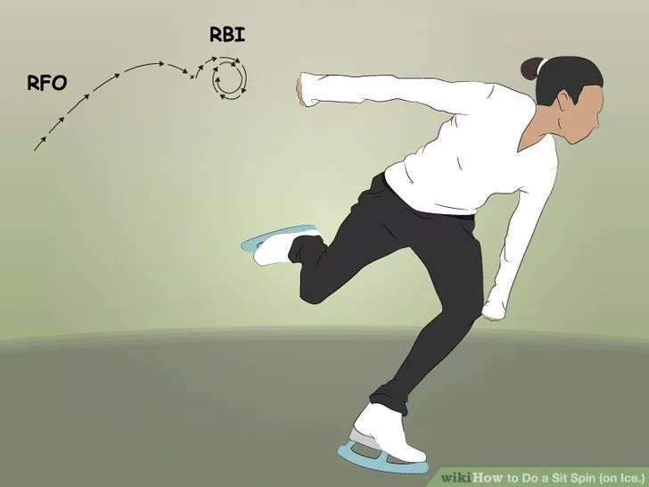
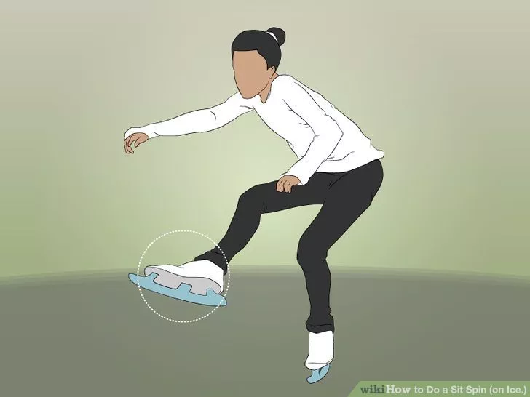
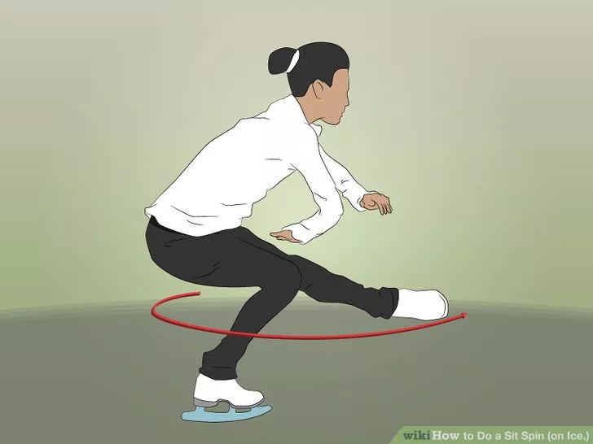
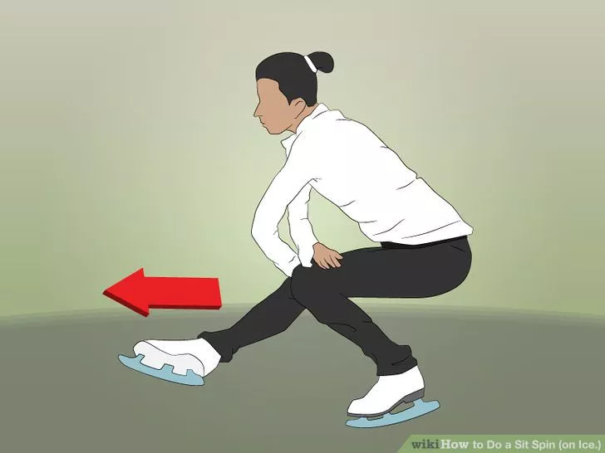
Breaking it Down
Start off doing backwards cross-overs
Step into an outside edge on the left foot with a bent knee and spin on that leg
Bring in your arms and your right foot
Keep the right foot in front of you and slowly straighten your left leg to get out of the spin

Slide 6
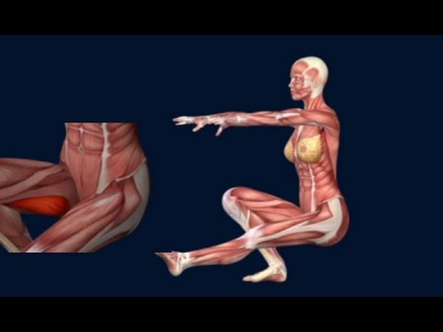
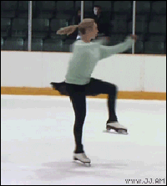
Tips on How to Improve/Make it Easier
Practice, practice, practice
Create a triangle with your hands
Strengthen the leg, stomach, and core muscles.
Maintain balance.
Spin on ball of foot
Center spin before going faster
Maintain good speed
Hannah Dalton

Slide 7
Suggested Exercises
Legs
Bending low and slowing rises back up on one leg.
Squats
Dips
Lunges
Stomach
Pull in Stomach
Core
Abdominal presses
Abdominal crunches
Planks
Push ups
Leg raises

Slide 8
Personal Experience
Notes:
1:32

Slide 9
Personal Experience

Slide 10
How the Professionals Do It
Notes:
1:47 HANYU
3:15 YULIA

Slide 11
Works Cited
https://en.wikipedia.org/wiki/Sit_spin
http://www.wikihow.com/Do-a-Sit-Spin-(on-Ice)
Shulman, Carole. The Complete Book of Figure Skating. Champaign: Human Kinetics, 2002. Print.
Hayes, John.“HOW TO DO A SIT SPIN | FIGURE SKATING ❄️❄️.” YouTube, uploaded by THINICE, 12 June 2015, https://www.youtube.com/watch?v=AiPc9xc6xzg&t=20s
“How to Sit Spin Figure Skating Spins Muscle Anatomy EasyFlexibility.”YouTube, uploaded by Elasticsteel, 14 January 2015, https://www.youtube.com/watch?v=IW8vrsB8-5k
“Figure Skate Comparison Guide.”Kinzie’s Closet,https://www.kinziescloset.com/skate-comparison-guide.html. Accessed 16 November 2016.
Schneider Farris, Jo Ann. "Exercises to Help Figure Skaters Do Sit Spins."AboutSports. N.p., 22 Apr. 2016. Web. 16 Nov. 2016.

