Slide 1
The Vacuole
By: Julianna H. and Maria C.

Slide 2
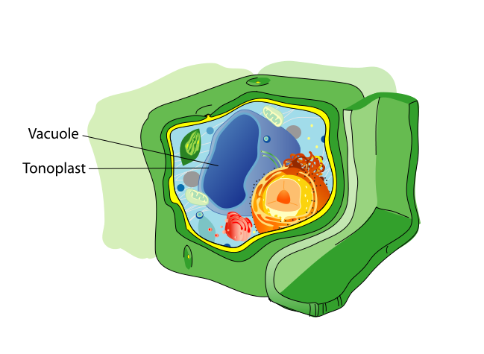
What is the Vacuole?
a membrane bound organelle
stores “food” for the cell
Nutrients
A bowl used for storage
Has its own Membrane called
tonoplast

Slide 3
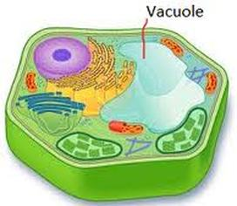
Function
The vacuole isolates substances that might be harmful to the cell and maintains an acidic internal pH. It also helps maintain turgor pressure within the cell as well as exports unwanted substances from a cell.
Other functions:
Contains waste products
Maintains hydrolastic pressure within a cell
Aid in destruction of invading bacteria
Assist in digestion and waste management of the cell
Can contain pigments which give color to some plants
Functions in Animal Cells
Vacuoles that exist in animal cells are:
Contractile, which function in maintaining osmotic pressure of cytoplasm
Non-contractile, which function in digesting food

Slide 4
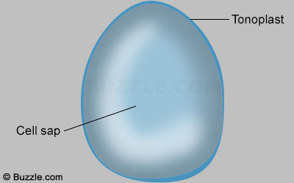
Structure
Tonoplast: separate membrane
Cell sap: holds nutrients for the cell

